Slide 1
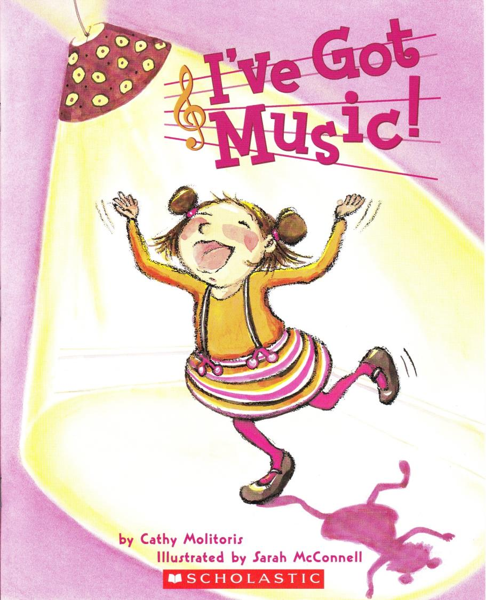
I’ve got music
By Cathy Molitoris
Illustrated by
Sarah McConnell

Slide 2
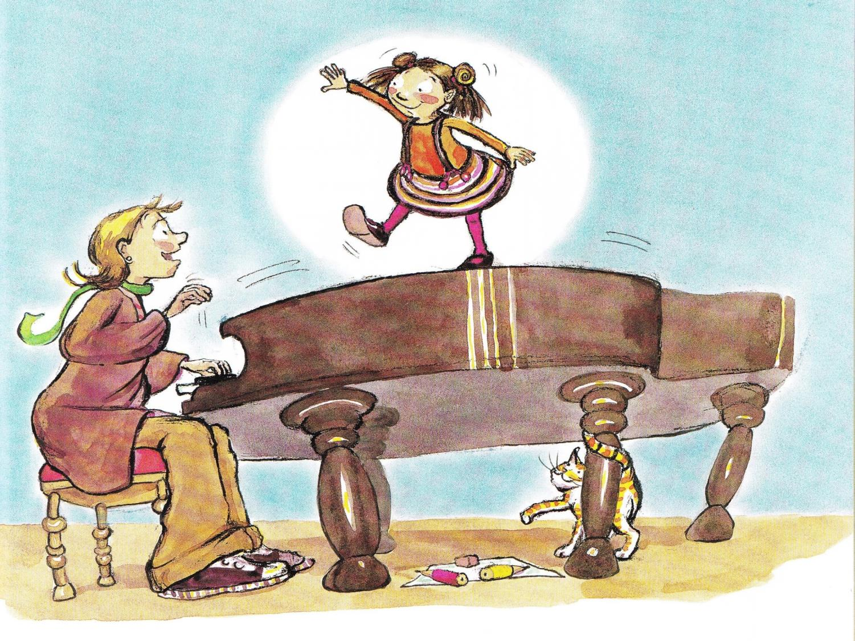
Notes:
Cora was a little girl who loved music –
Not the kind of music you or I love, although she did enjoy a good piano recital.
Instead, Cora loved the music she heard all around her every day.

Slide 3
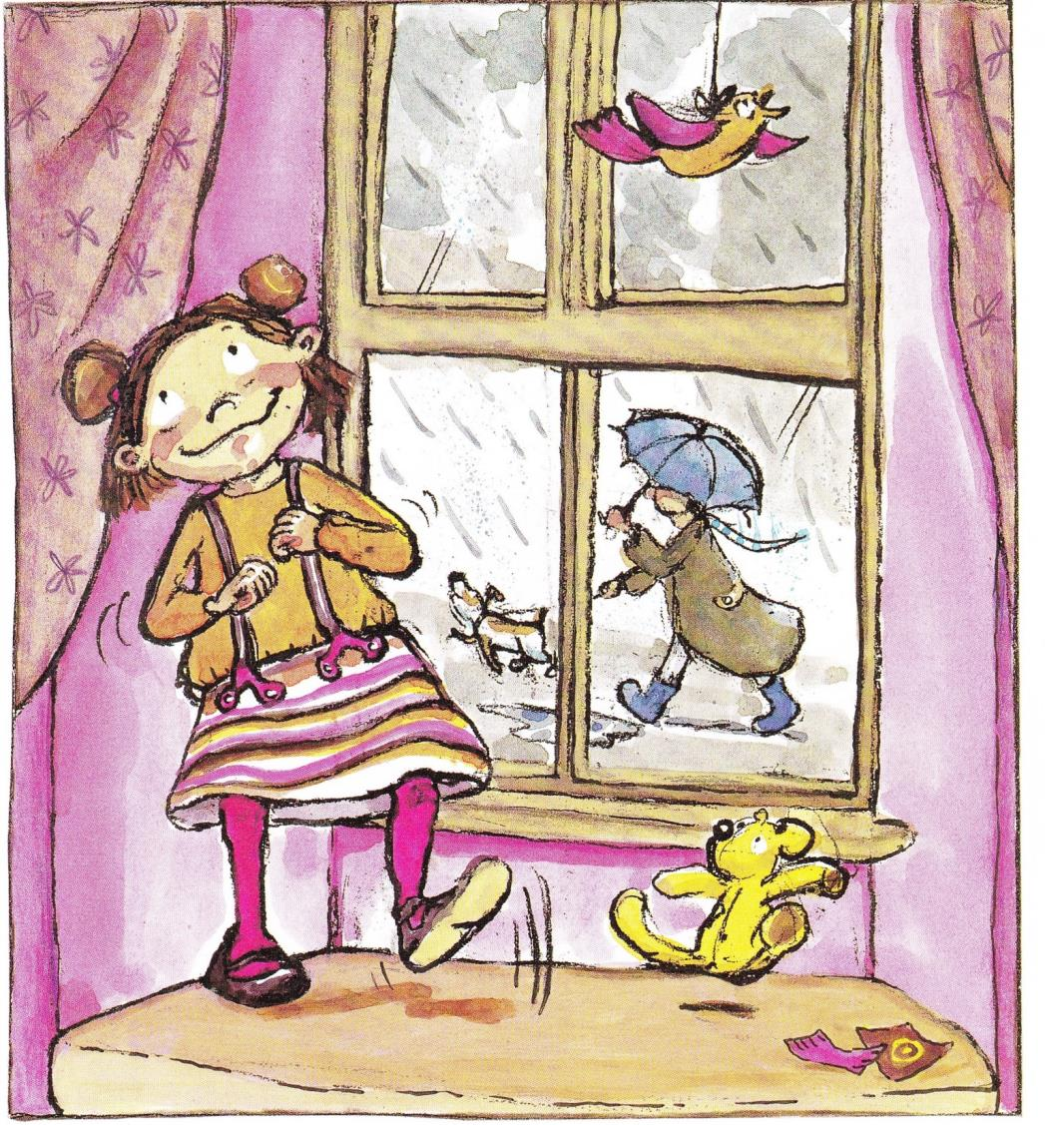
Notes:
She loved to TAP TAP TAP her feet to the PAT PAT PAT of rain on her bedroom window.

Slide 4
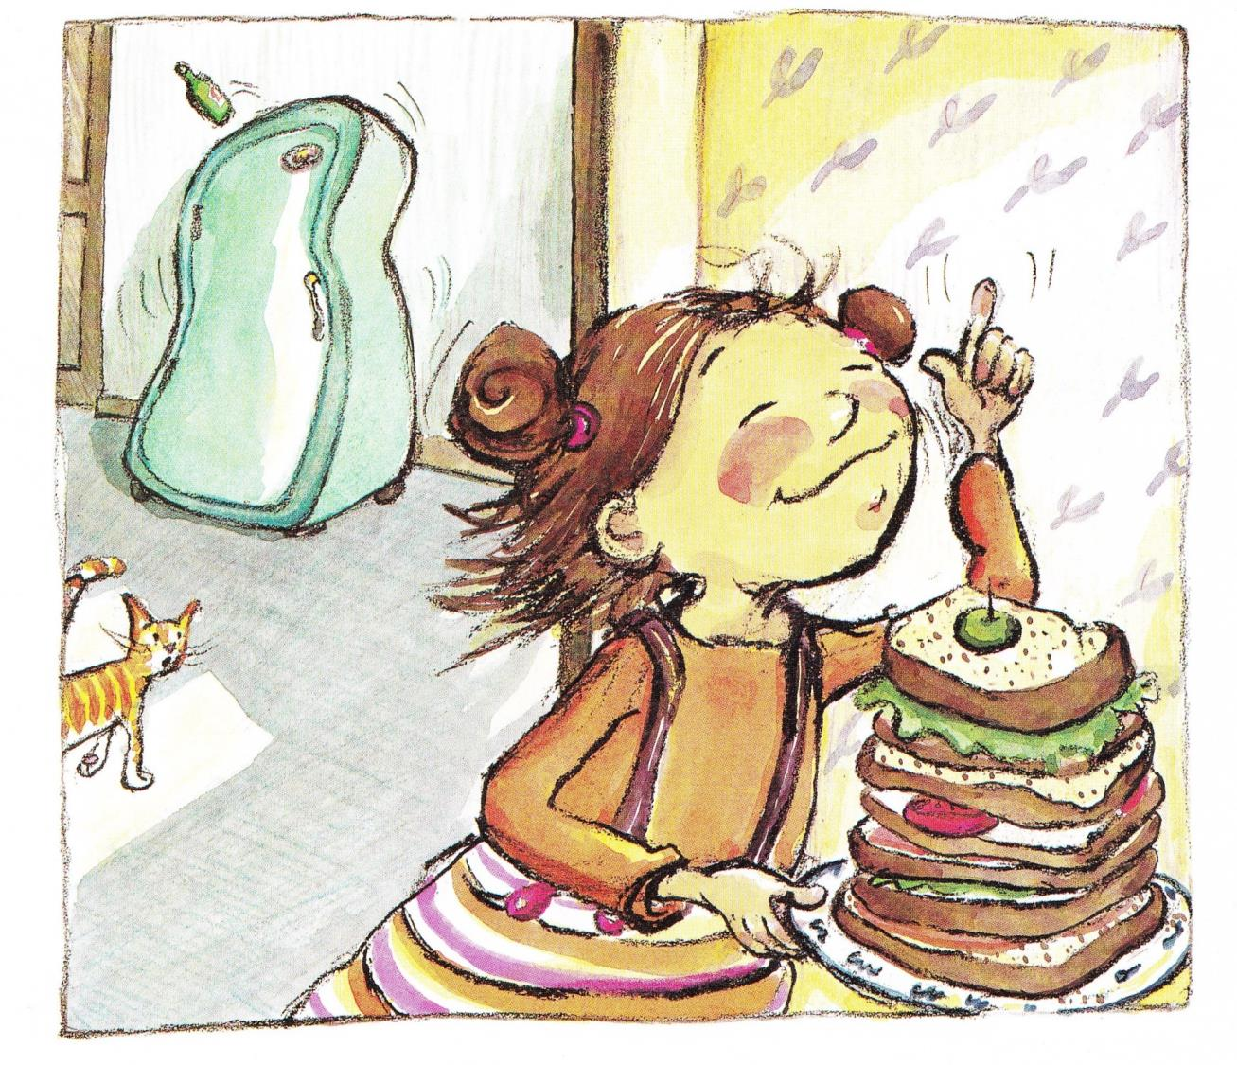
Notes:
She loved to hum along to the low BUZZZZ of the refrigerator.

Slide 5
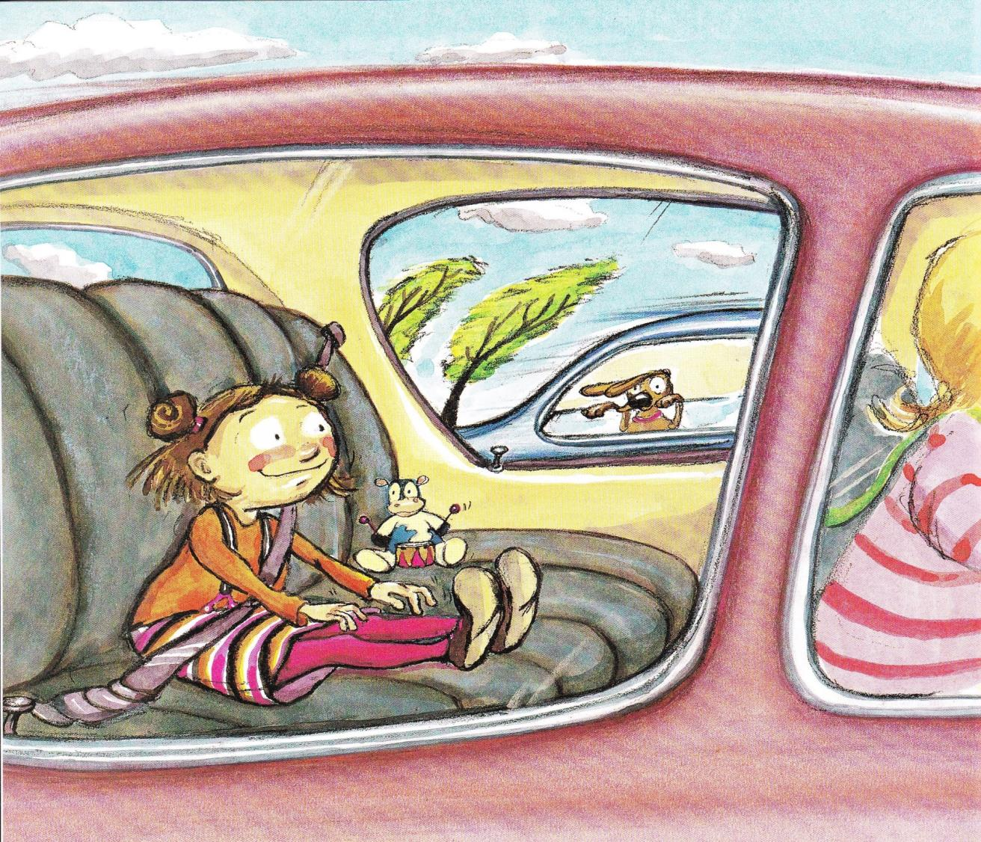
Notes:
DRUM DRUM DRUM went her fingers on her knees while she sat in the car.

Slide 6
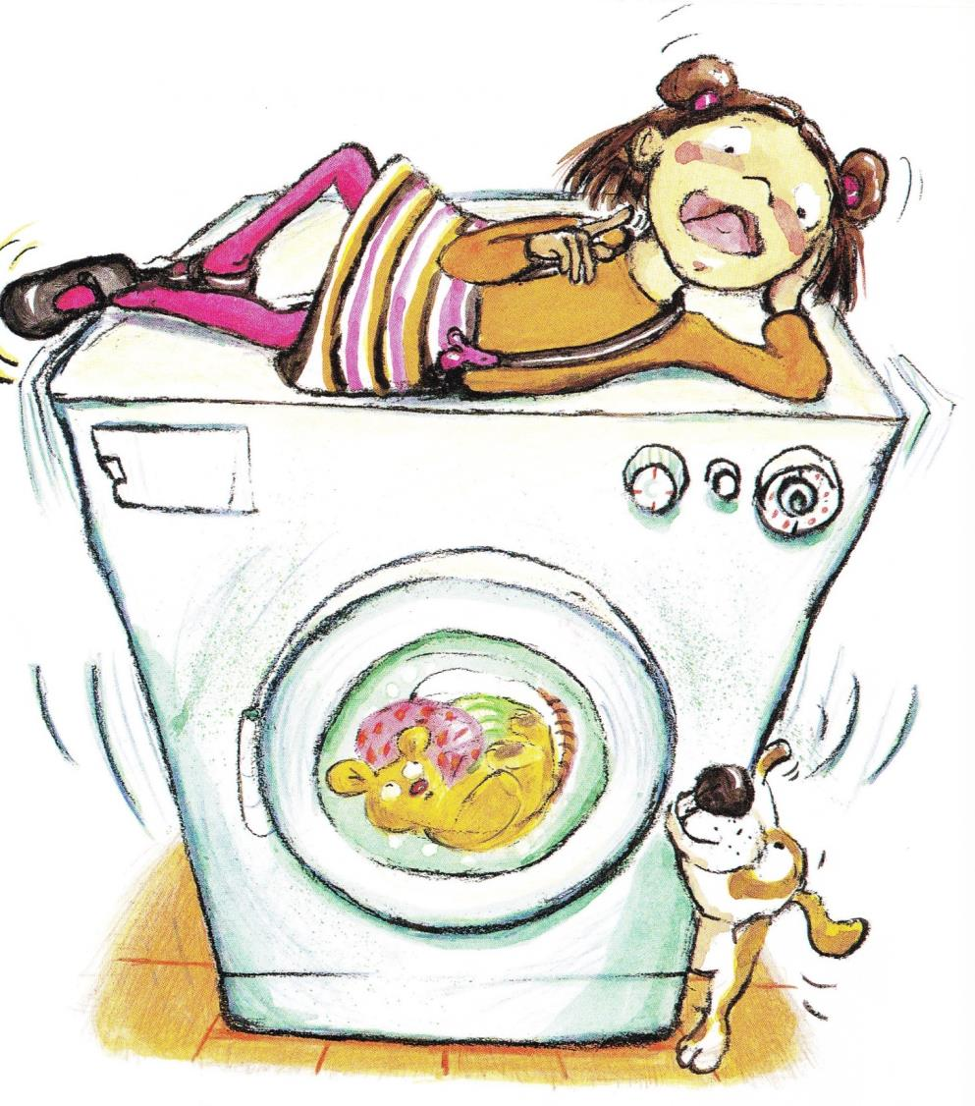
Notes:
CLICK CLICK CLICK went her tongue on the roof of her mouth as she listened to the thumping beat of the clothes dryer.

Slide 7
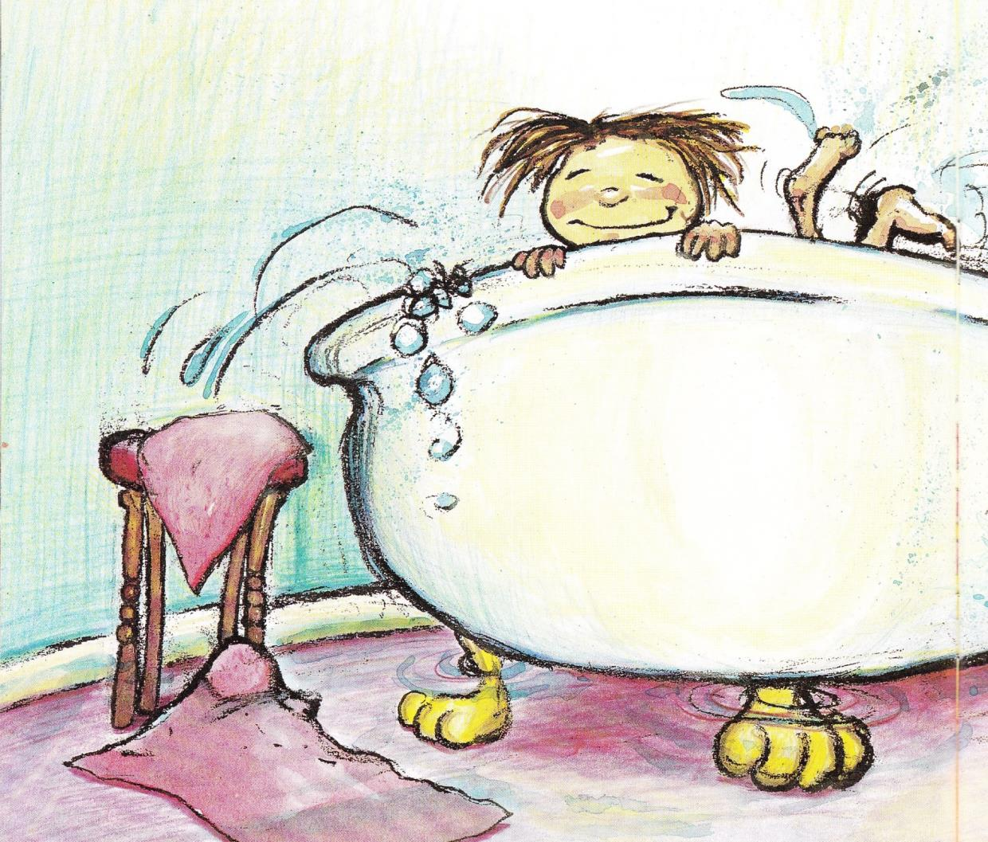
Notes:
Cora couldn’t imagine a life without music or drumming or clicking, but plenty of people around her could. When she SPLISH-SPLASHED her feet to the beat in the bathtub, she sometimes SPLISH-SPLASHED water all over the bathroom.

Slide 8
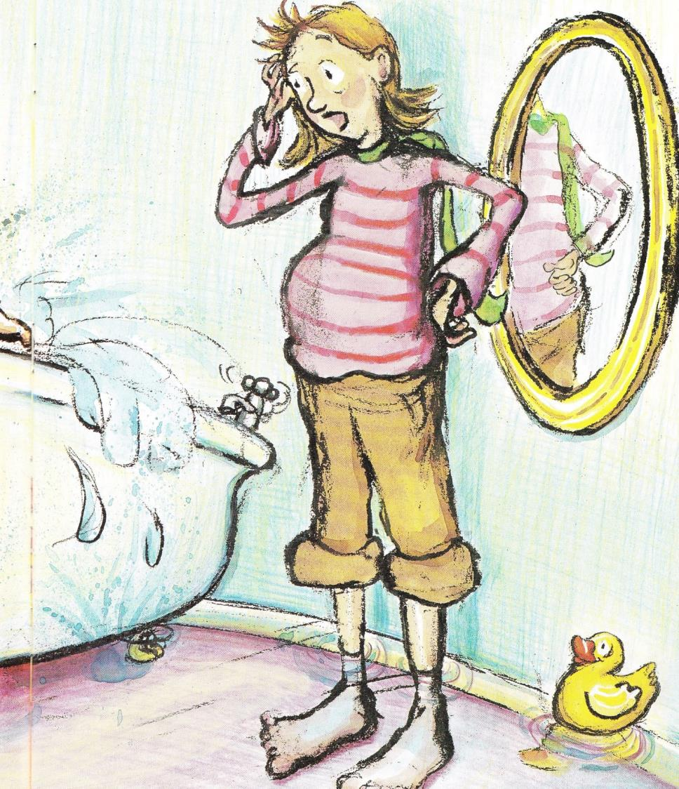
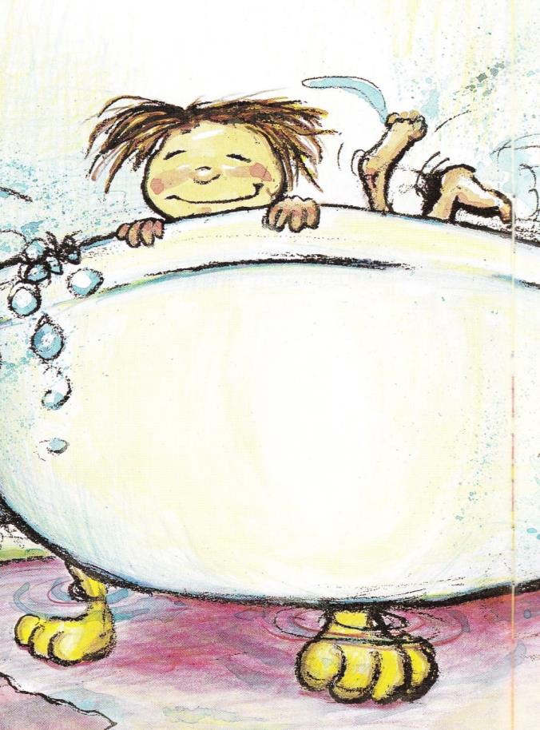
Notes:
“let’s keep the water inside the tub,” her mother would sigh.

Slide 9
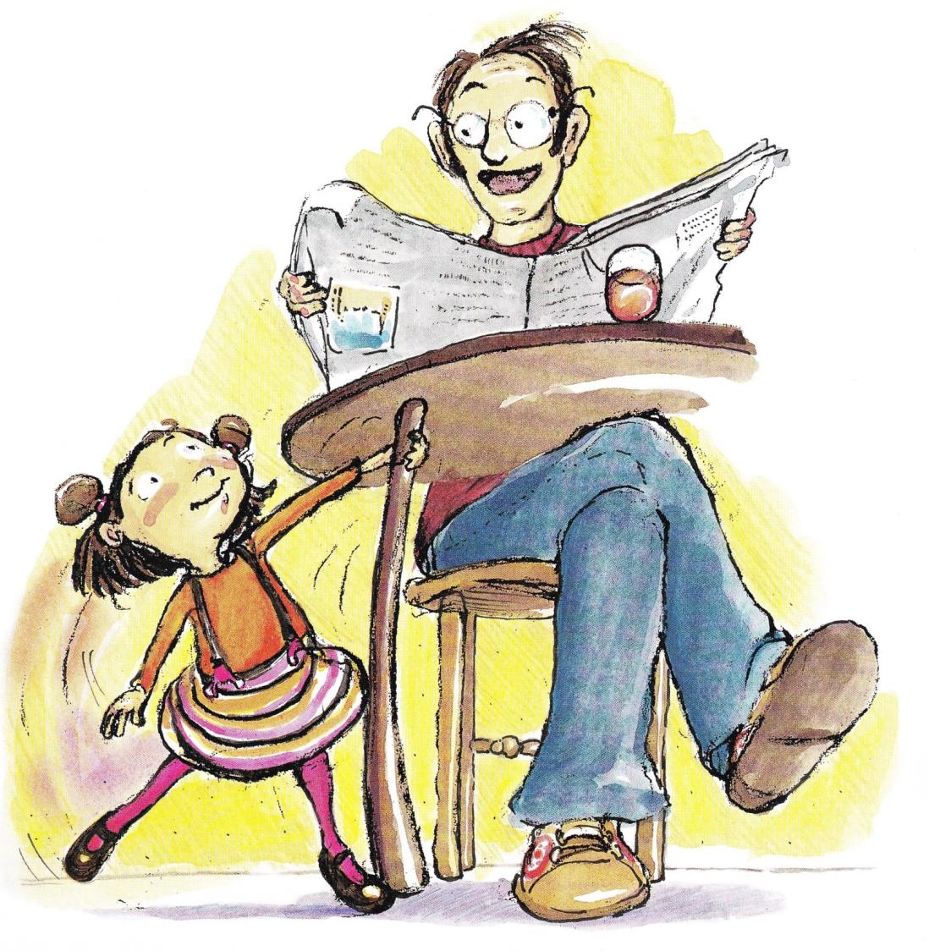
Notes:
When the tapping of her feet on the kitchen floor distracted her father from reading his paper, he would say, “Cora, please keep quiet.”

Slide 10
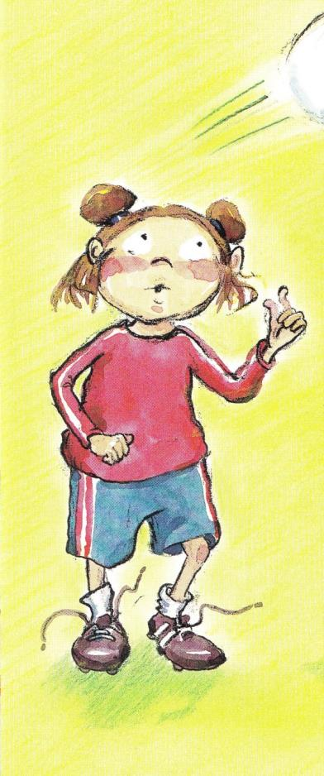
Notes:
At soccer practice, she would puff her cheeks in and out with the rhythm of sneakered feet as they swooshed on the grass.
“Cora,” her coach would command when the ball sailed past her. “Concentrate on the game, please.”

Slide 11
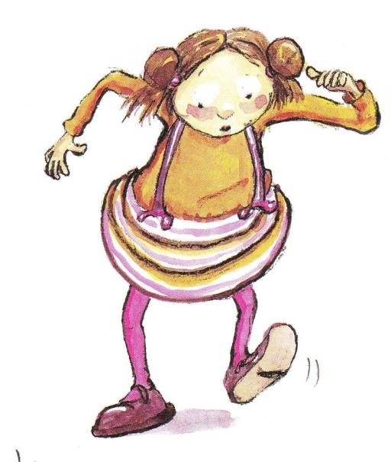
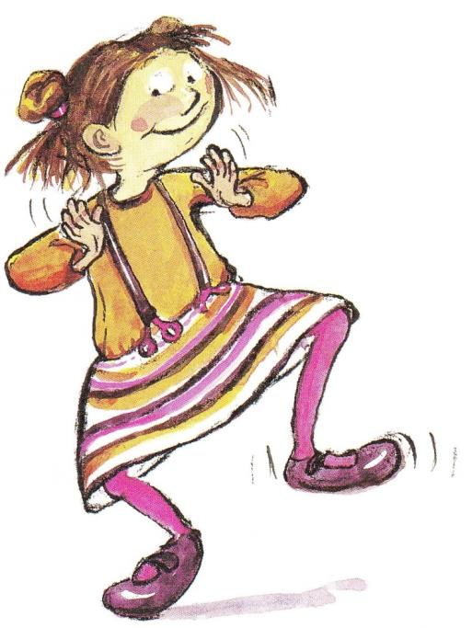
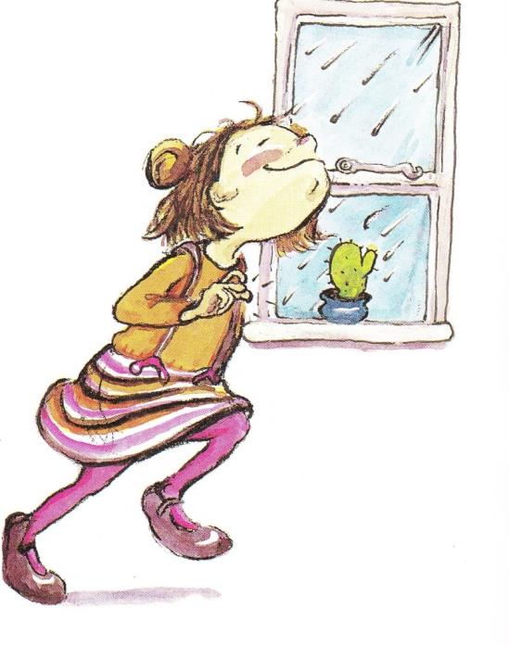
Notes:
Still, nothing could stop Cora from TAPPING, CLAPPING, and SNAPPING. She tried to keep the music to herself, but it was hard.

Slide 12
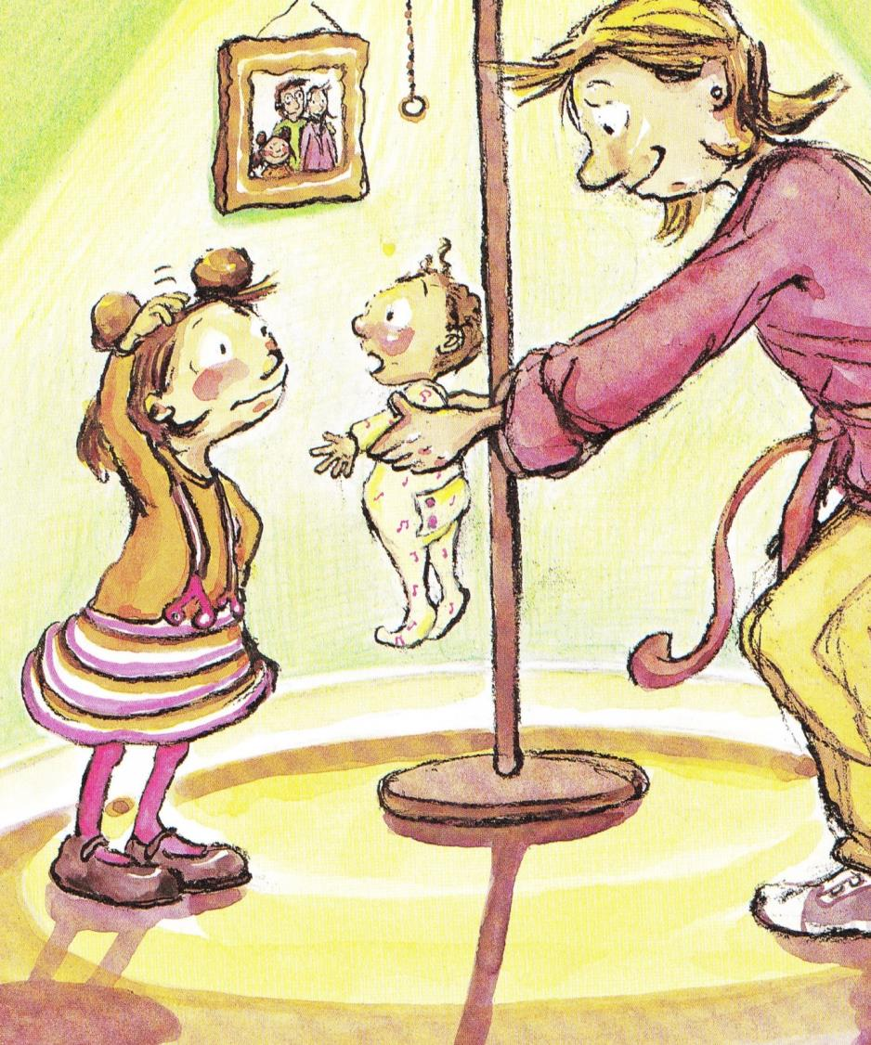
Notes:
Then one day, Cora’s mommy brought a baby sister home from the hospital. Cora couldn’t believe how tiny she was! All she did was sleep, eat, cry, sleep, eat, cry.

Slide 13
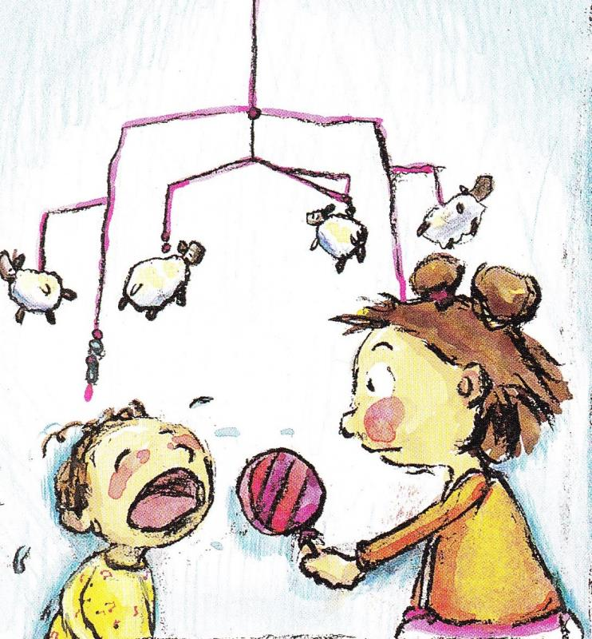
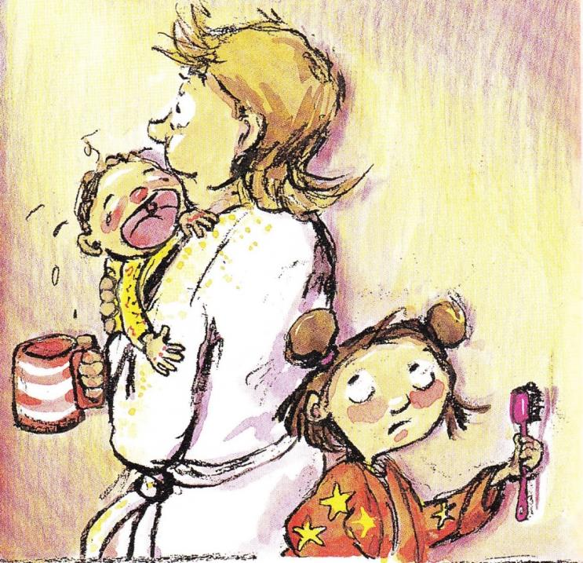
Notes:
And she cried a lot. She cried in the morning.

Slide 14
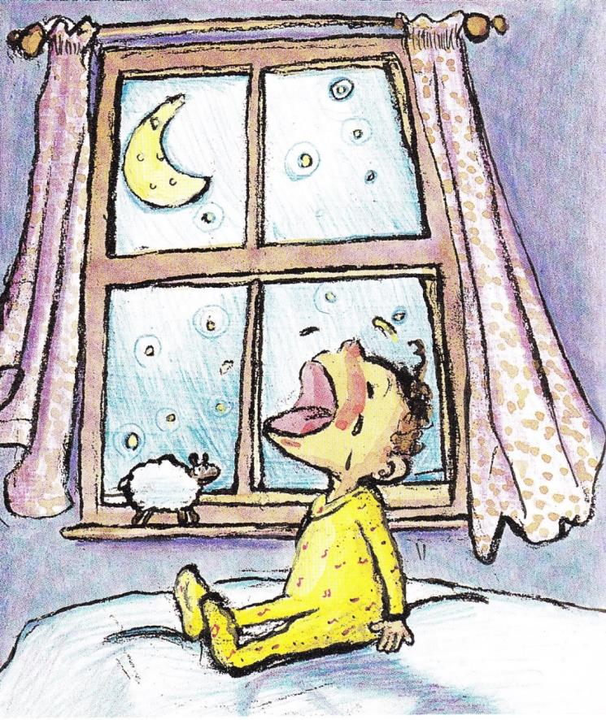
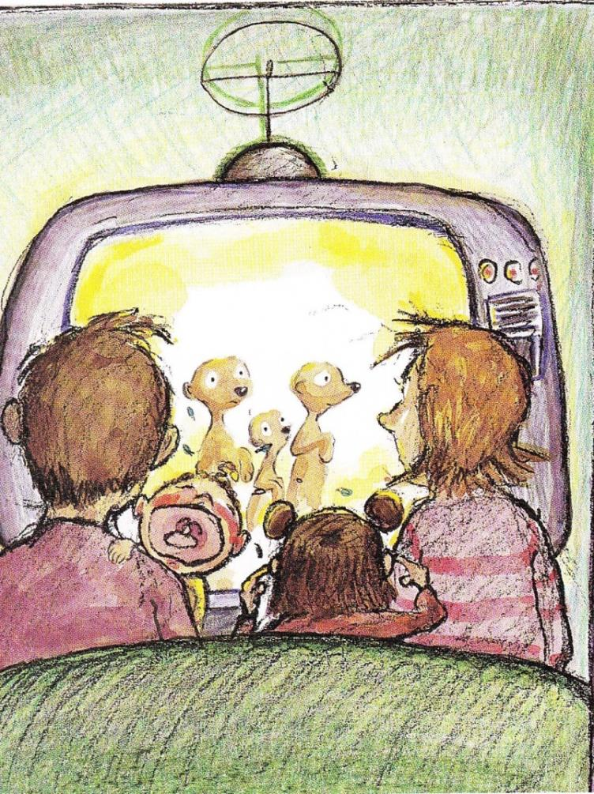
Notes:
She cried in the evening. She cried all night.

Slide 15
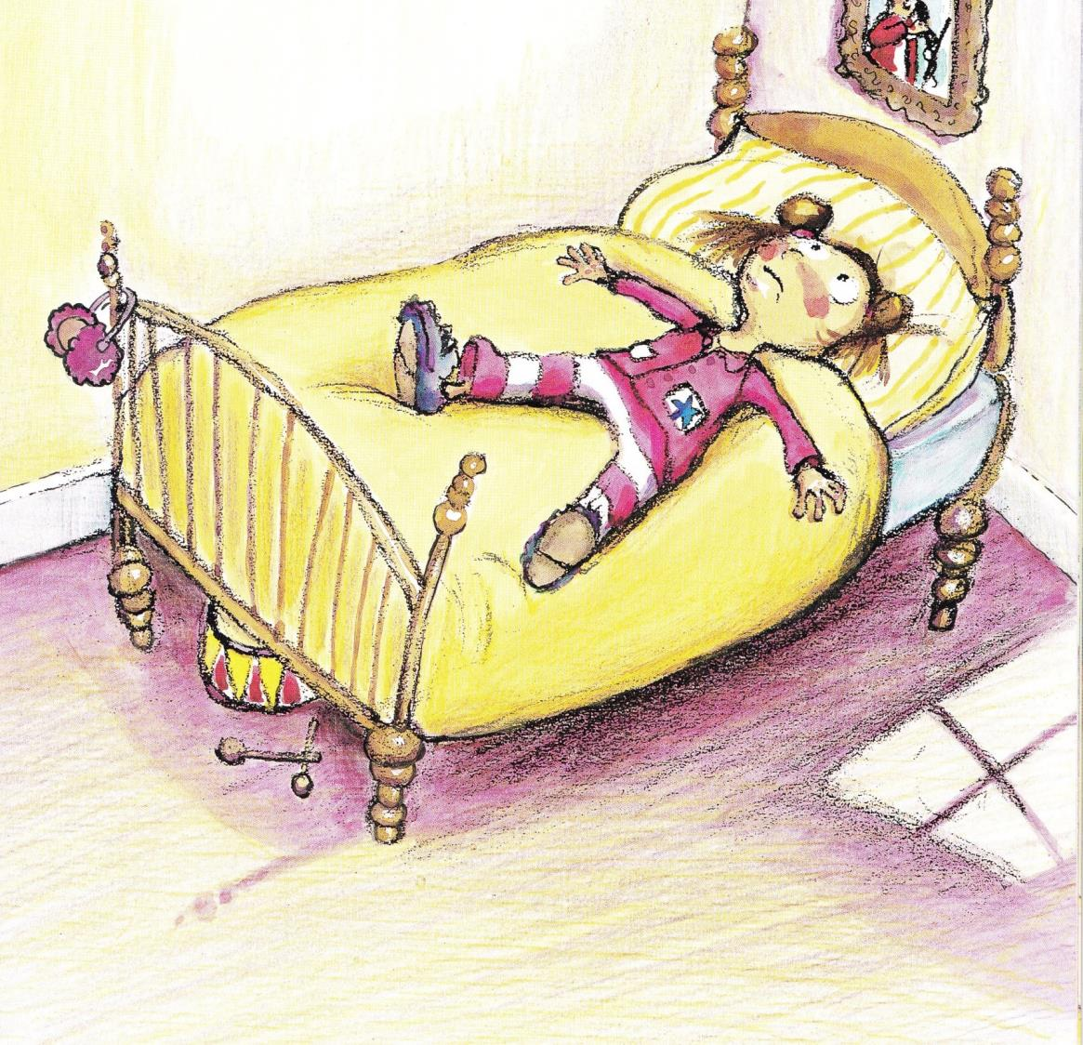
Notes:
Cora tried to concentrate on her music, but it was hard to do. The crying drowned out all the usual noises in her house.

Slide 16
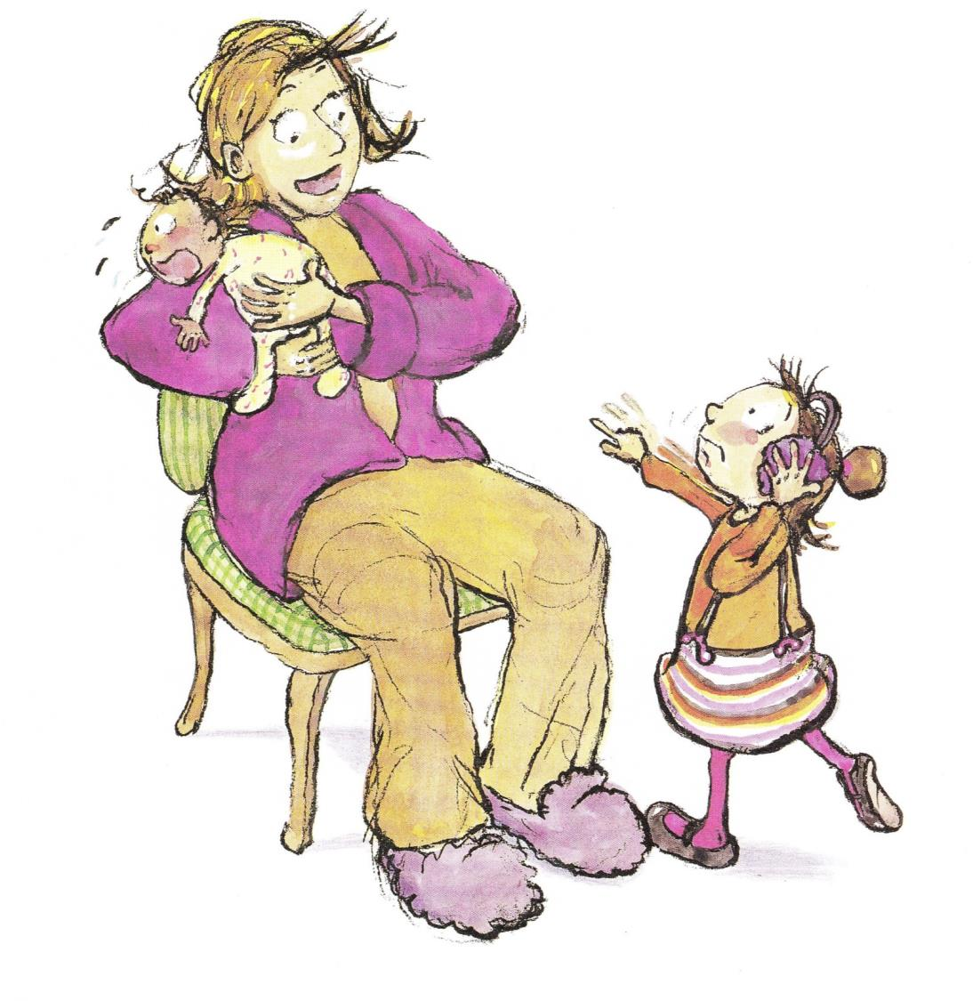
Notes:
She complained to her mother. “Babies cry,” her mother said. “You just have to get used to it.”

Slide 17
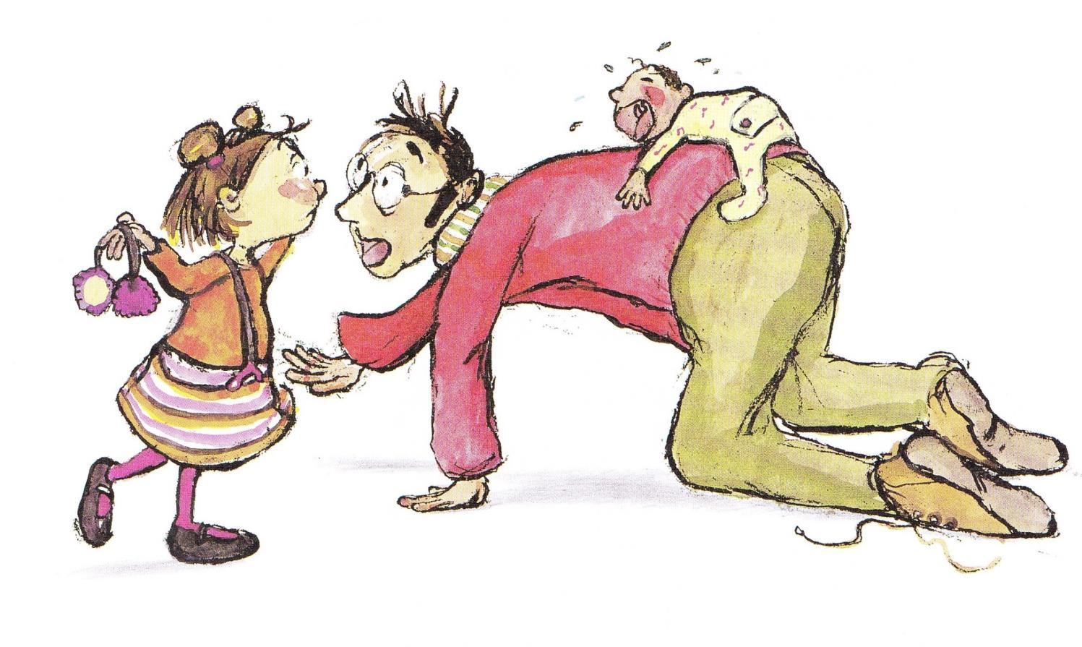
Notes:
She complained to her father. “Try to ignore it,” he said.

Slide 18
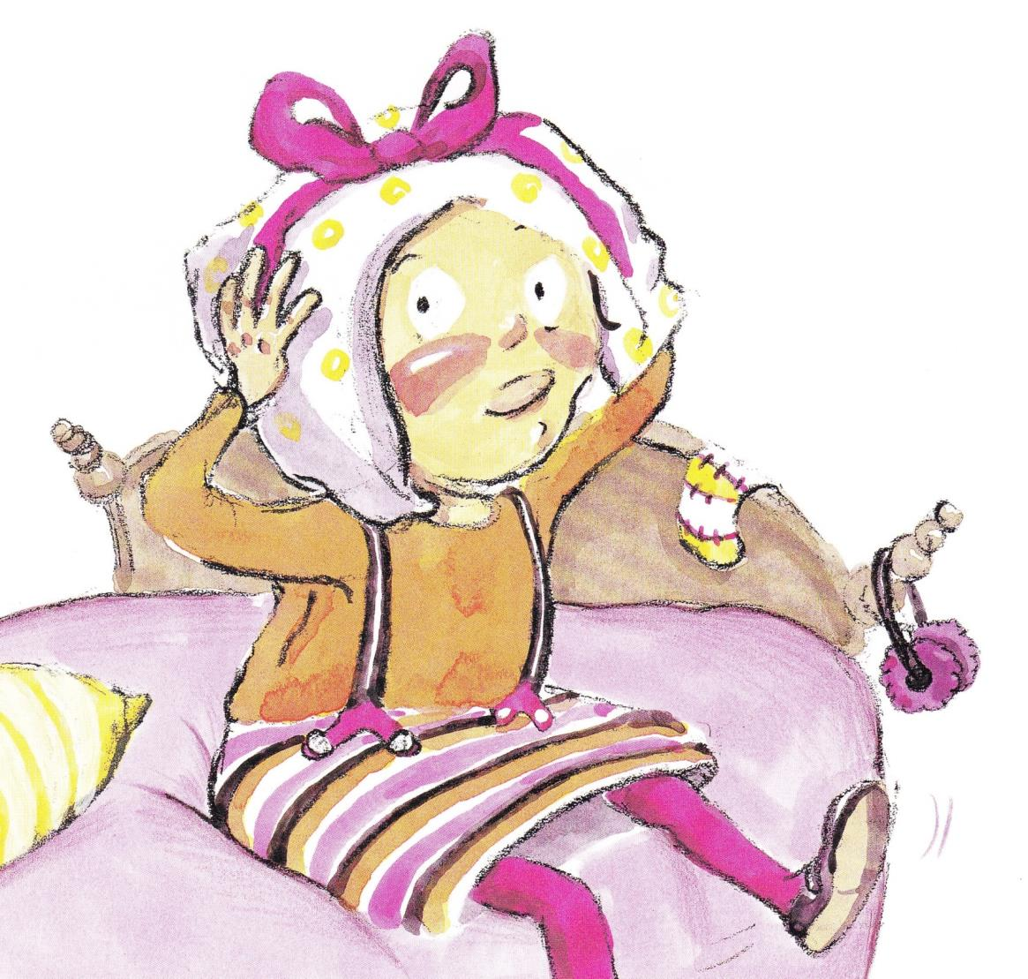
Notes:
Cora sat on her bed and pouted. She tried to hum a tune, but it wasn’t easy. She couldn’t hear anything but “WAH WAH WAH!” over and over again.

Slide 19
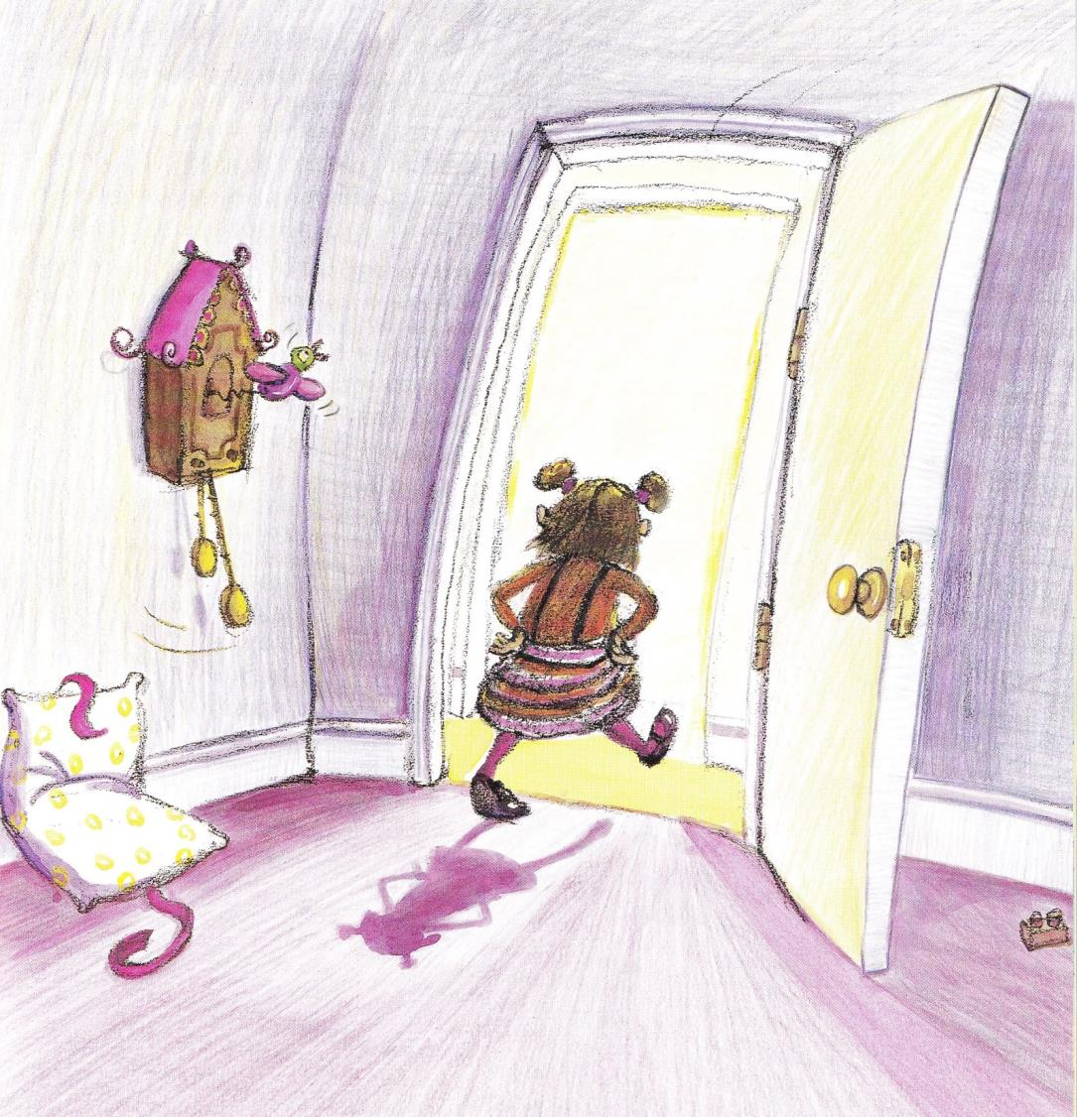
Notes:
Finally, she got up and went into her sister’s room.

Slide 20
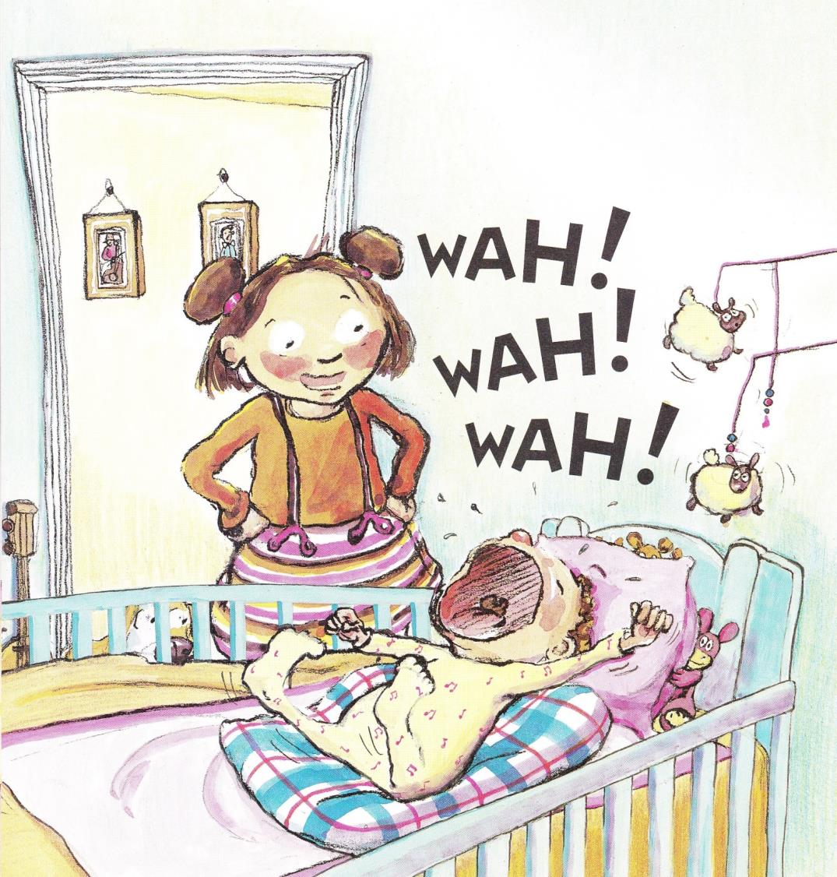
Notes:
“For a little baby, you make a big noise,” she scolded. “Why can’t you just be quiet?”

Slide 21
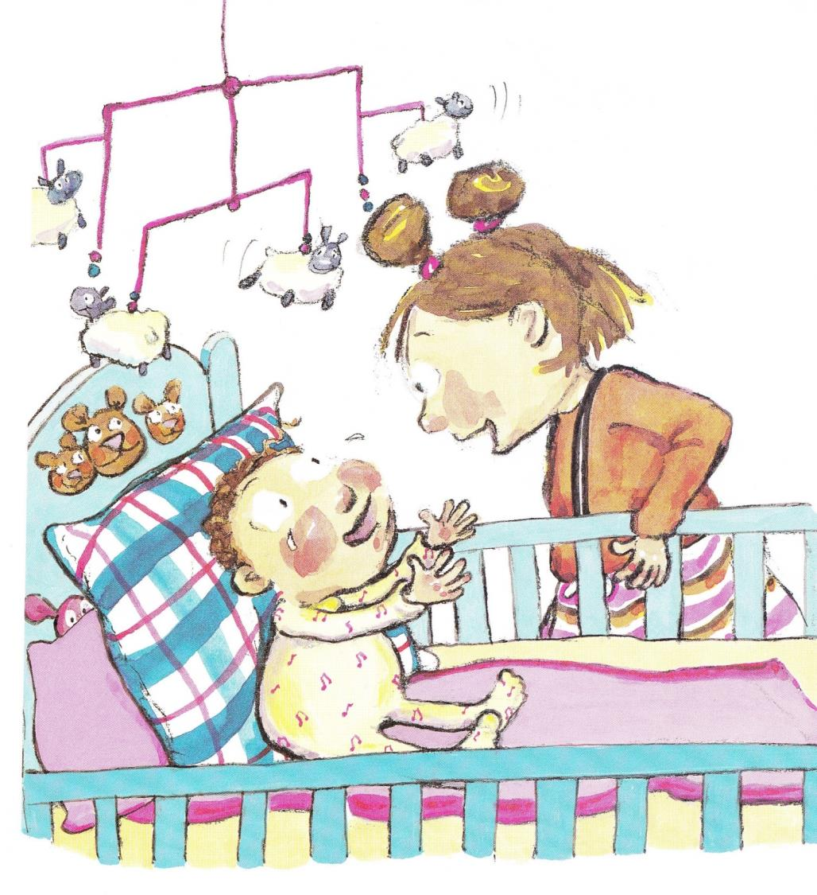
Notes:
Her sister stopped crying, looked at Cora, and started crying again.

Slide 22
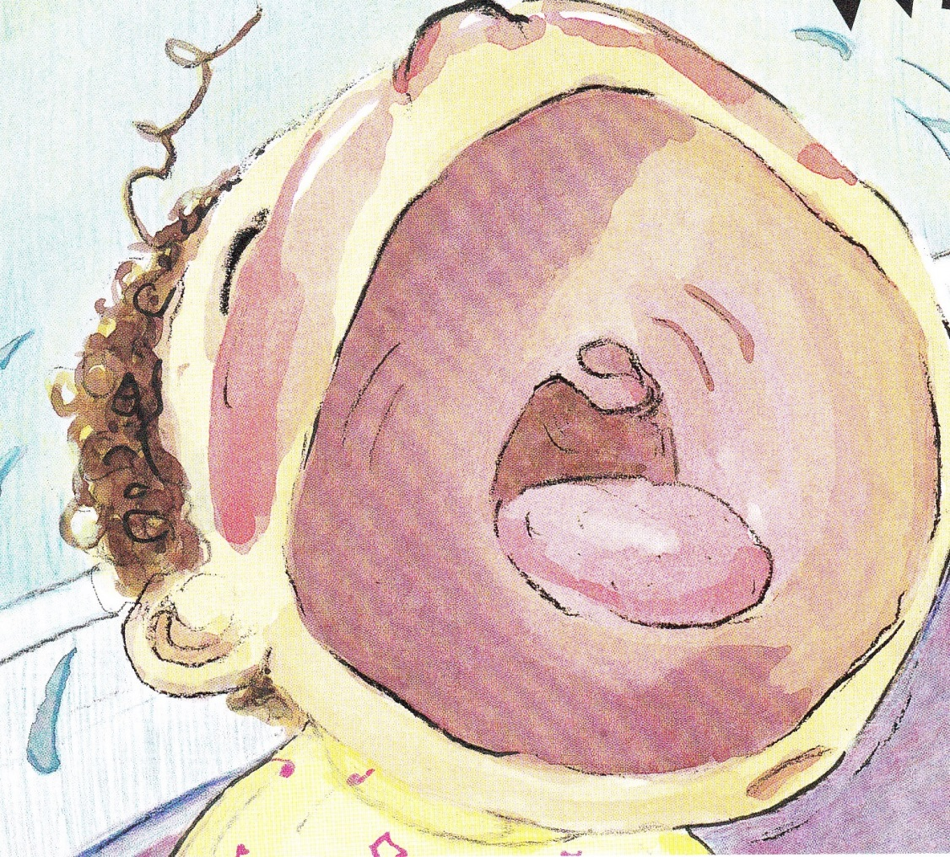
Notes:
WAH WAH WAH!

Slide 23
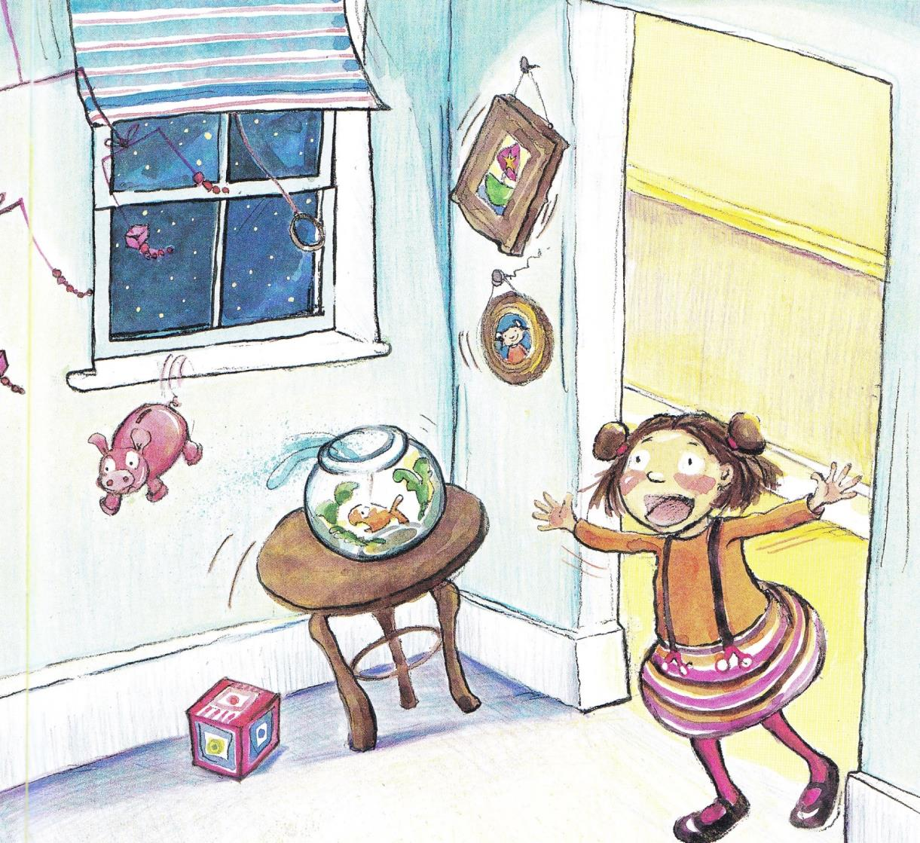
Notes:
Cora turned to leave the roo, but then suddenly she stopped. She listened carefully. Could it be? She wondered. Was it possible?

Slide 24
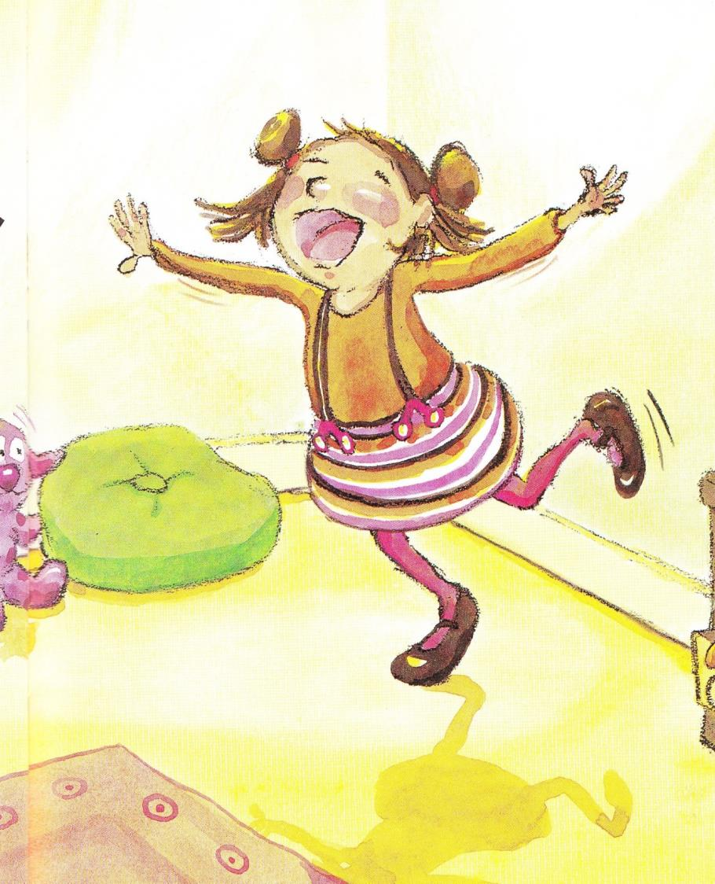
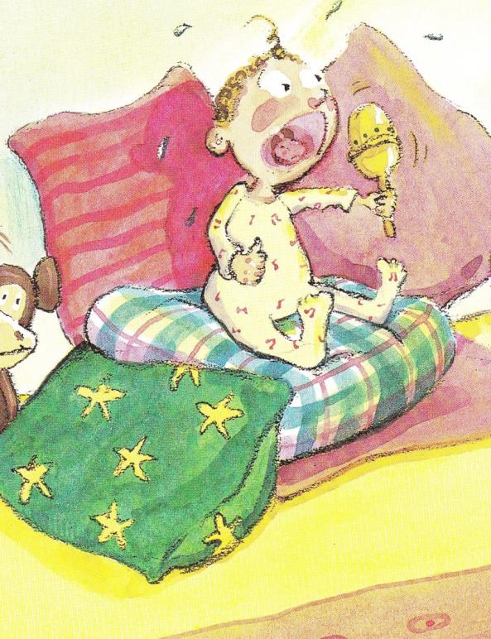
Notes:
WAH! WAH! WAH! Could her sister’s crying actually sound like music?

Slide 25
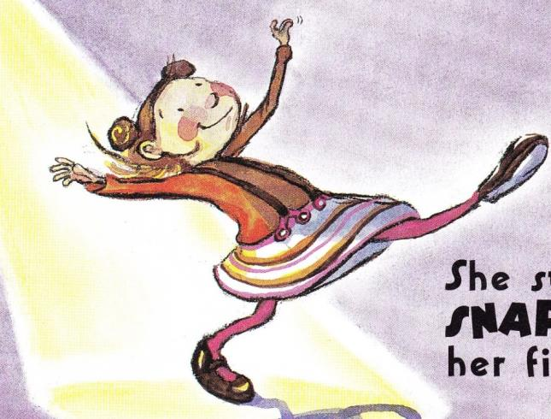
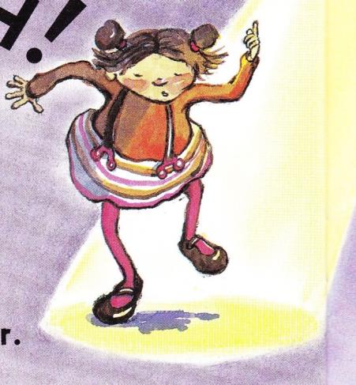
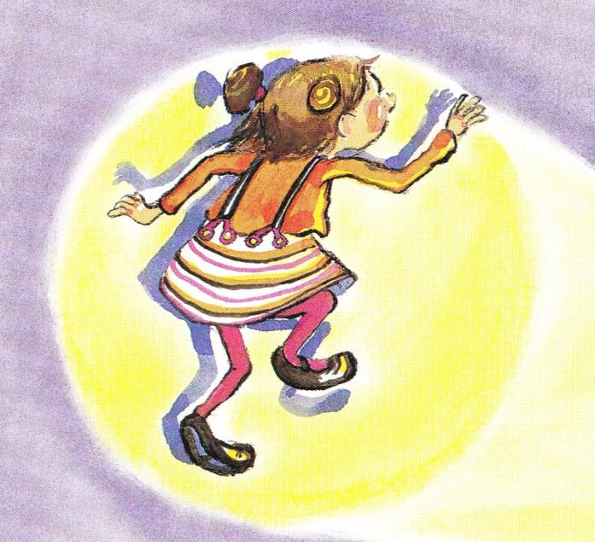
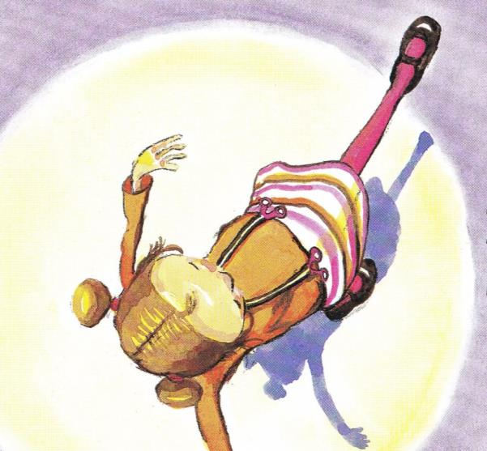
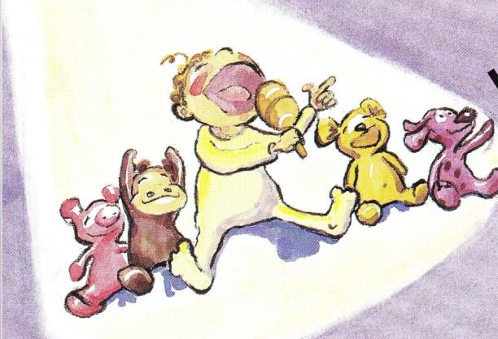
Notes:
Cora had to admit the crying had a rhythm to it. WAH! WAH! WAH!
Before she knew it, Cora began to TAP! TAP! TAP! Her feet on the floor.
She started to SNAP! SNAP! SNAP! her fingers.
And she HUMMED a soft tune. Then she HUMMED a little louder.
Soon she was TAPPING, SNAPPING, and HUING with gusto.

Slide 26
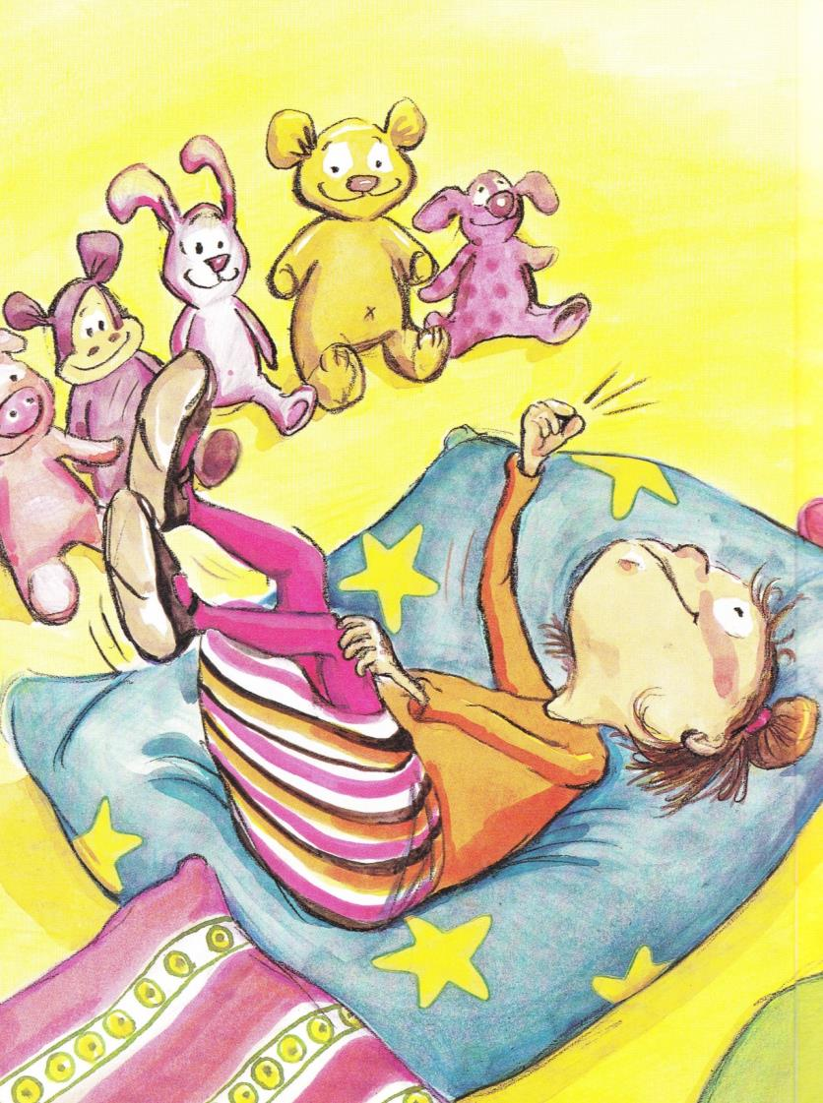
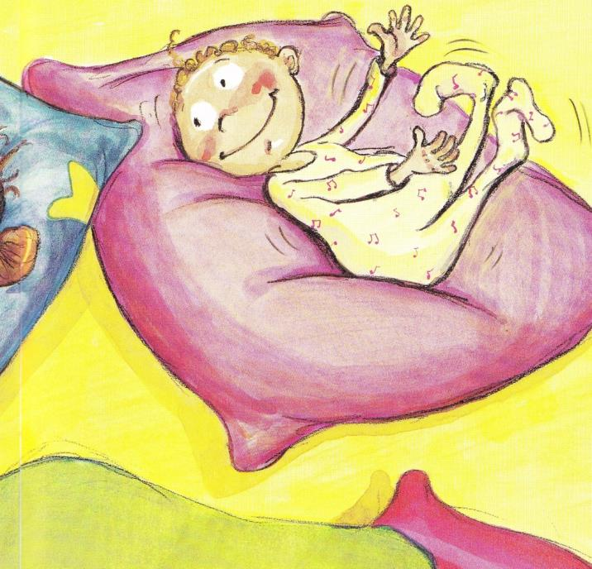
Notes:
Then something amazing happened.
Cora’s sister stopped crying.
She watched Cora with fascination.
Slowly, she began to smile.
Then she began to GIGGLE and WIGGLE.
She kicked her feet and waved her arms.
She SQUIRMED with delight and squealed with joy.

Slide 27
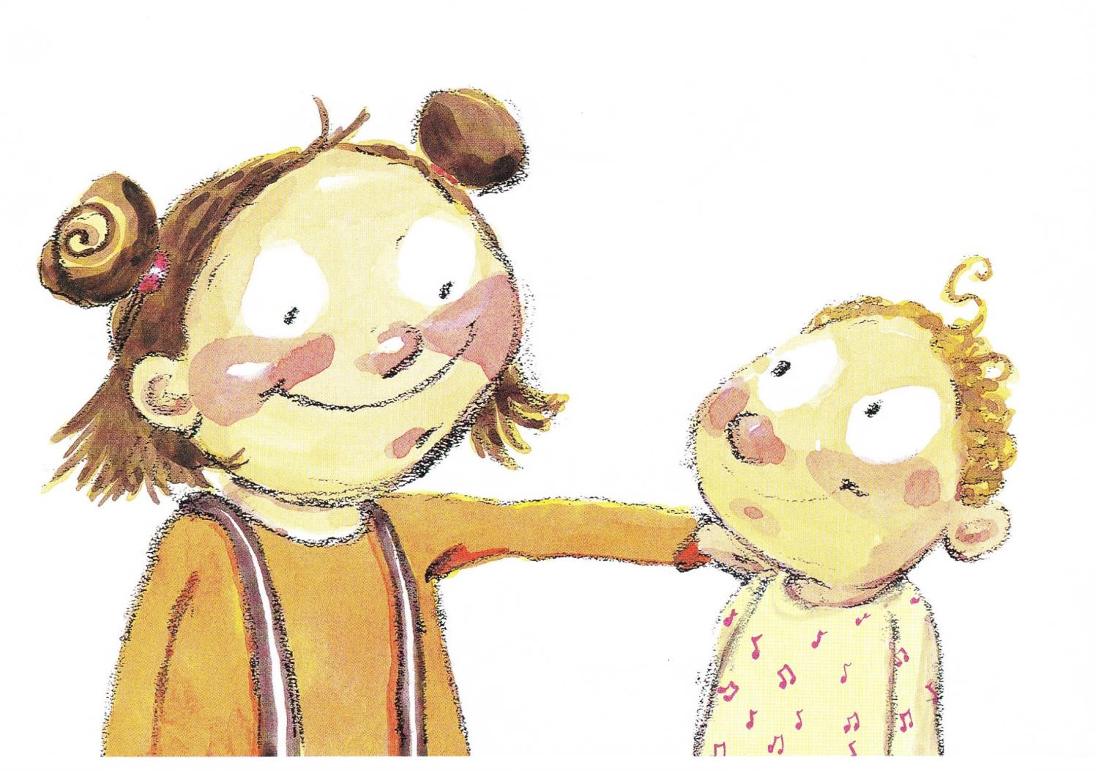
Notes:
And Cora smile a giant smile because she knew right then that she had finally found someone who appreciated her music as much as she did.

Slide 28
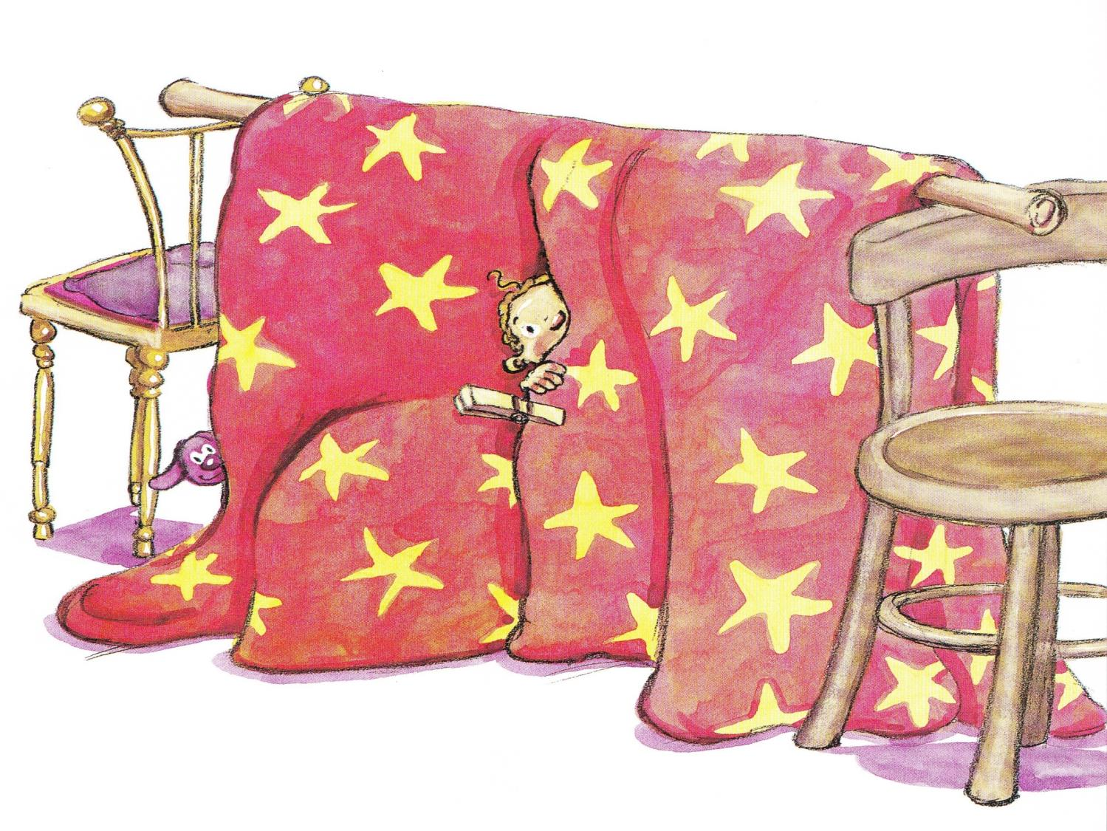
Notes:
With all the COOING and GIGGLING, Cora didn’t just have a new baby sister...

Slide 29
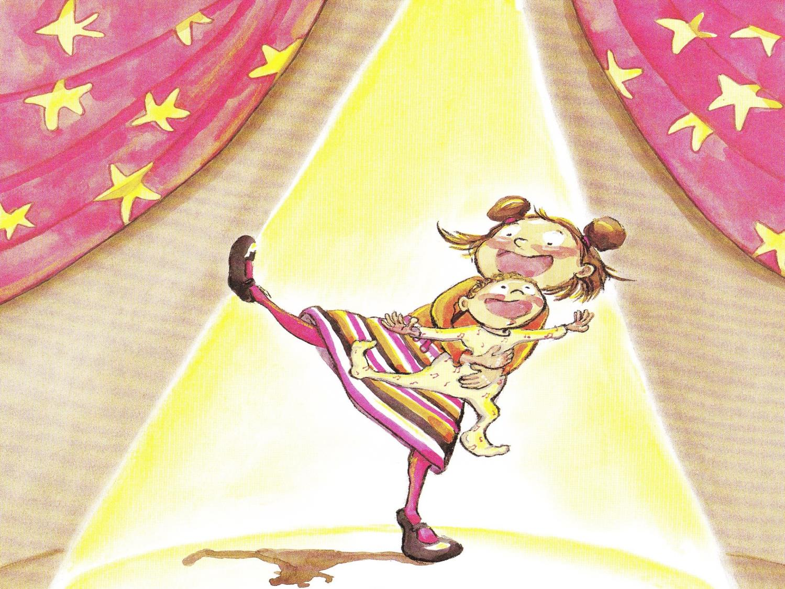
Notes:
SHE HAD A BAND.

