Slide 1
Creating Opportunities
Through a Child’s Eyes
Notes:
*Good afternoon. My name is Peter Wickham. I am an English Language Training Fellow with Brighton Education Learning Services, operating out of IPG Kampus Dato’ Razali Ismail in Kuala Terengganu. I was born and raised in Perth, Western Australia, although I have lived, trained and worked in Australian Aboriginal schools, Papua new Guinea, the Torres Strait, China, Turkey, The UK, Saudi Arabia, Queensland, and now Malaysia.
For 20 years I taught Primary School students in Australia before heading with my wife to teach ESL to adults in exotic settings from 2004 onwards. My wife is also a Training Fellow at IPGKDRI in Kuala Terengganu. I believe that she is presenting a workshop today.
Malaysia is an amazing country. Everywhere we look we see optimism, tolerance and belief that this nation is progressing towards a brighter tomorrow – something that is sadly missing in many parts of the world today, even in First World countries. We are very pleased to live and work here.
And I am likewise honoured to present this Keynote Address for this conference.
I trust that tonight you will go home with more than just a free lunch. I truly hope that you will be inspired by the workshops you see here today.
Our conference theme is * Creating Opportunities – * Through the Eyes of a Child.
*

Slide 2
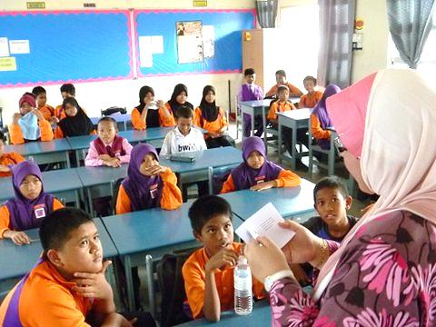
Notes:
We are all very familiar with the scene you can see on this slide. What can you see? Many people Would say “I can see a classroom” or “I can see a teacher teaching her class” or maybe even “I see children listening to their teacher”. We can almost smell the aroma of 40 sweaty bodies, hear the drone of the grass being cut outside, and imagine the students thinking about what they are going to have for lunch today. Sound familiar? These reactions to the question, “What can you see?” come from a bygone era when the teacher spoke at the front of the class, students politely pretended to listen, and lessons consisted of a list of facts to learn.
*

Slide 3
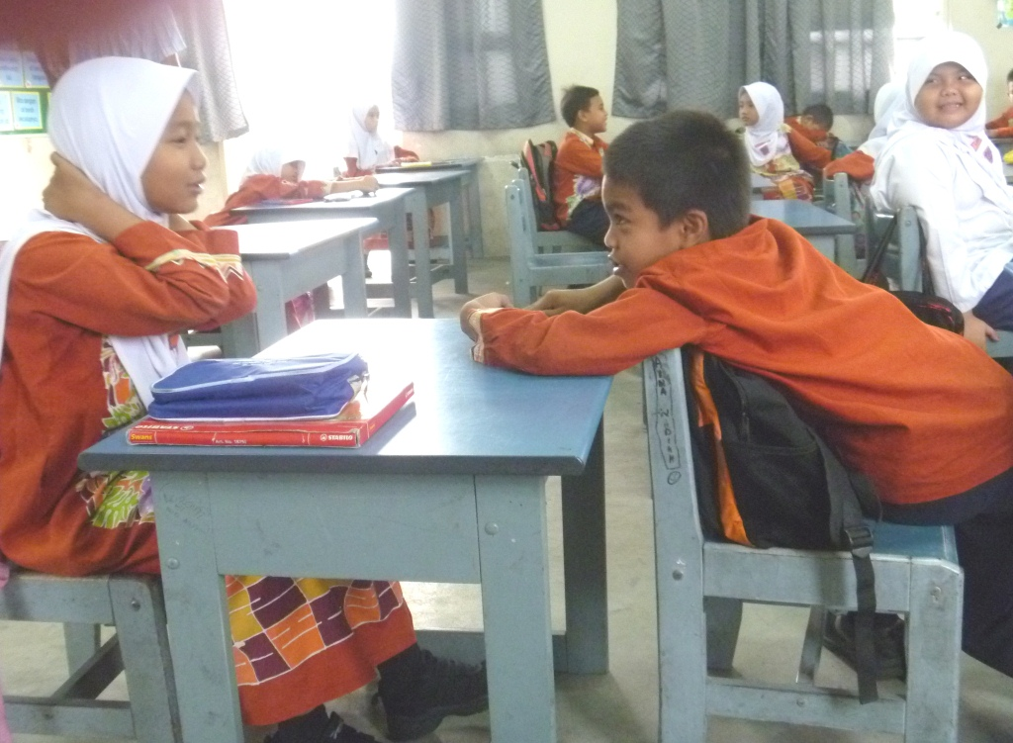
Notes:
When we look closer, we begin to see more detail. Here we can see children communicating with each other. We begin to wonder who these people are. Where do they live? What are their names? What are they talking about? It may occur to wonder which school they attend, in which state of Malaysia. How old are they? What are their favourite school subjects? What is their routine outside of school? When viewed in smaller groups, our students invoke in us a more personal interest.
*

Slide 4
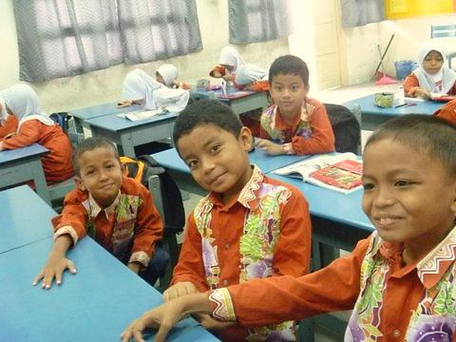
Notes:
Closer still and we can see their faces. We can see the spark of intelligence in their eyes. Some of them are looking right at us and we can see a line of communication open there. This is what every teacher sees every day in class. We are no longer seeing just a classroom, a teacher and some students. We are looking at young people who have a natural curiosity about their world. They are much more than just empty vessels to fill up with facts and figures; they are real people who are earning their place in Malaysian society.
As they progress with the studies they will begin to make choices about their future.
We can remember when we were that age, and yet we have all moved on to where and what we are today, largely with the help and guidance of hard-working and dedicated parents and teachers who encouraged us along the way.
I can remember a lot of things from when I was this age in school. And yet I now have 4 children and 7 grandchildren. I had the uneasy distinction of turning 60 last month. Where did the time go?
*

Slide 5
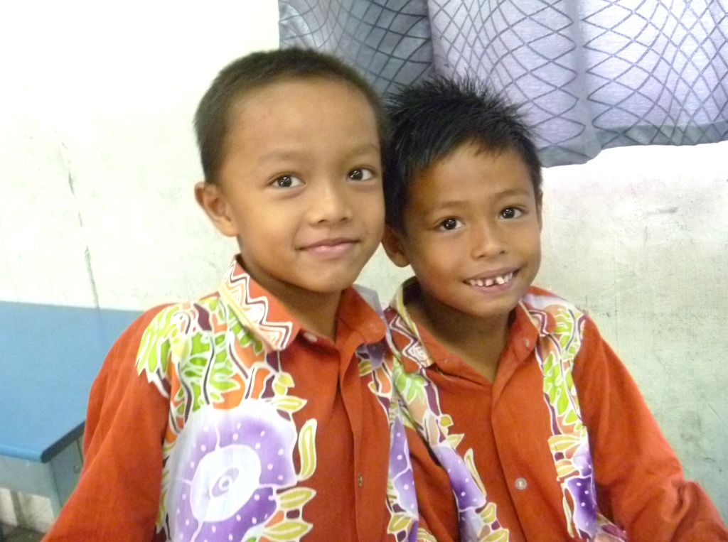
Notes:
As we delve deeper we begin to see individual differences. We see relationships between students. We can see hopes and aspirations in their eyes. We can imagine these same students in 10, 15, 20 years. Where will they be? What will they be doing? What will their world be like? What challenges will they face? How will they cope? What stories will they have about their early school years? What will they remember most about their schools and their teachers?
To a large extent, we as educators will shape many of the answers to these questions. What a responsibility!
*

Slide 6
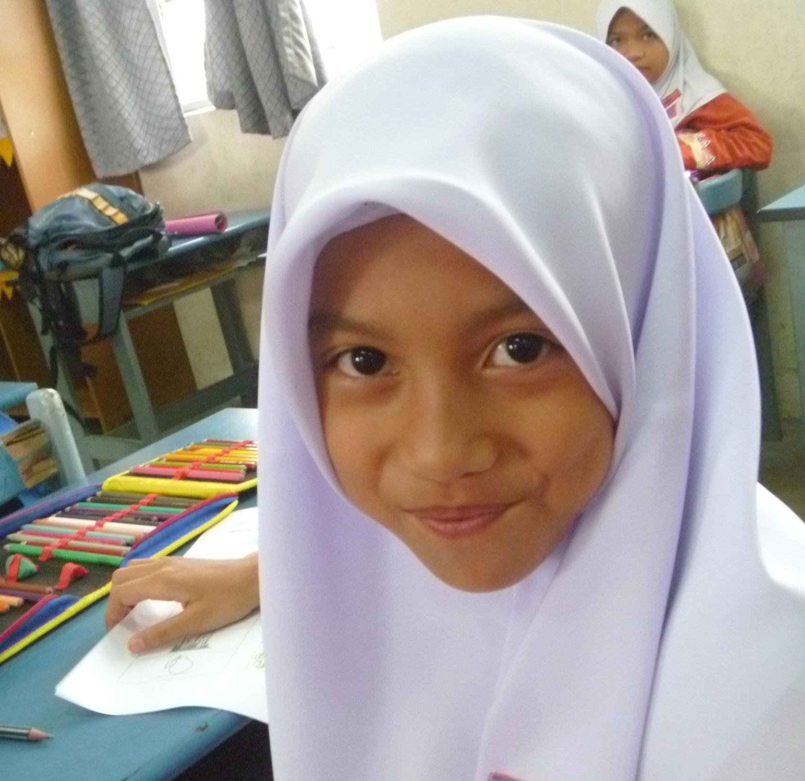
Creating Opportunities
Through a Child’s eyes
Notes:
When we encounter an individual student we encounter a private world. This student is unique. There is no-one in the whole world exactly like her. As educators, it is our task to lead this individual through their educational years into as much learning and development as possible. It is our job to capture her attention, to foster her creativity, * and to create opportunities for her to shine. Who knows what treasures of intelligence and wisdom lay behind these eyes? *
It is our privilege to find out. This point of interaction between student and teacher will always be the primary interface of education. All of the technology of today and of tomorrow cannot erase this reality. I have read of teachers being “learning navigators” for their students, meaning that a true teacher leads the student into learning situations, where that student can eventually learn for themselves, following the learning techniques they have acquired from their teachers, and meeting life’s challenges by themselves. A student at this stage of development is often called “an independent learner”. This is our ultimate goal for any student in our care.
*

Slide 7
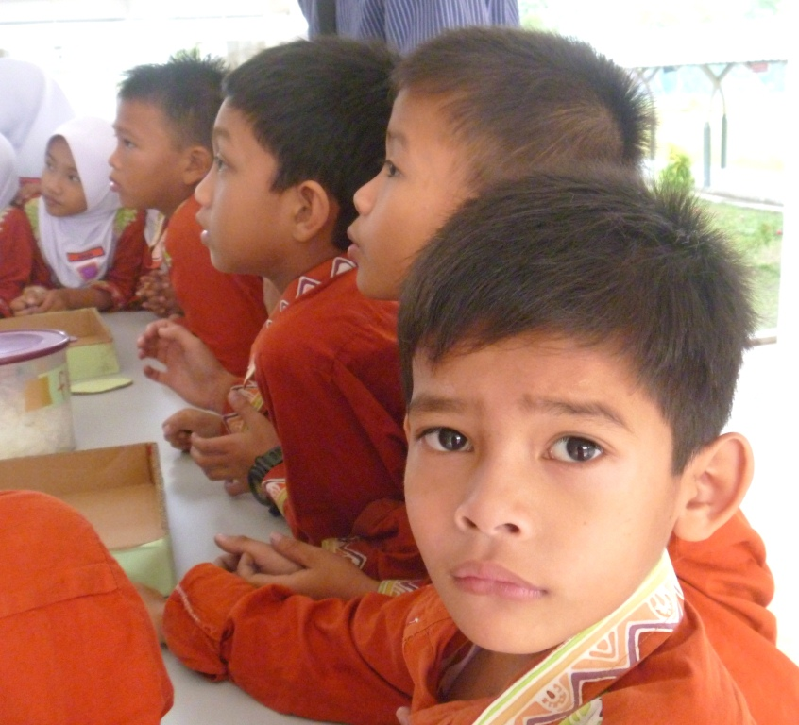
Creating Opportunities
Through a Child’s eyes
Notes:
Is this a future Prime Minister? A talented artist? An influential industrialist? A husband? Father? Whatever his station in life, we as teachers and school administrators are all agreed that we want to develop his skills to the maximum through sound pedagogy. All of our efforts, all of our resources and all of our educational programs need to be aimed at capturing his attention and interest in the things that really matter in life. Behind these eyes is the future of Malaysia.
*
It is these learning opportunities that will give this child the best chance in life for health, prosperity and happiness.
If we ever become mechanical in our jobs and lose the spark of excitement that comes from leading young people to productive adulthood, just look into the eyes of the nearest child and remember the sacred trust that we have. Think about the future of your country and your people, and realize afresh that you are an active part of shaping that future. This is a high calling and it is a privilege to be an integral part of it.
*

Slide 8
http://www.epu.gov.my/html/themes/epu/html/RMKE10/rmke10_english.html
Notes:
Everyone ought to have a plan in life, even if that plan has to be regularly revised.
Every family leader ought to have a plan. A family budget, a plan for the children’s education, a plan for retirement, a plan for emergencies, a plan for financial security.
We are very fortunate that Malaysia has a plan. The Tenth Malaysia plan, in operation from 2011 to 2015, points the country towards development from Third World Status – to Developing Country (which I believe Malaysia has already achieved) to First World status in all aspects of life. If you have not already done so, look it up at www.epu.gov.my It makes for absorbing reading. The 10th Malaysian Plan covers most aspects of the future of Malaysia during the years 2011 to 2015. No doubt in 2016 there will be another plan after the effectiveness of the current plan actions is reviewed and assessed.
*

Slide 9
Notes:
Chapter 5 of the 10th Malaysia Plan is of particular interest for educators. Its Title is Developing and Retaining a First-World Talent Base. Inside this document are several testimonials to other countries that have already made this transition.
Obviously a First World Talent Base cannot be just imported like so many sacks of wheat or so many foreign cars.
This talent base is to developed at home, here in Malaysia. This means a type of training that has not been a traditional part of the Malaysian scene in past years. This means big changes in the way things get done.
I read in a financial magazine some time ago that only a crazy person does exactly the same thing time after time and expects the outcome to be different this time. If a fisherman is not catching fish, he will devise a plan to change his outcome. He will change the bait he uses, change the equipment he uses, or change his fishing location. He can even change the plan completely and go to the fish market for fish. He may be frustrated at times, and he may be disappointed with some plans, but he will keep changing the plan until he gets the outcome. If all he wants is peace and quiet, he may be happy dangling an empty hook in the water and hoping that no fish will bother him.
Either way, a plan is essential to solving a problem. And the Malaysian government sees a gap between traditional pedagogy in Malaysian schools and the educational outcomes needed for a First-World status for Malaysia.
*

Slide 10
“The development of human capital in Malaysia requires the collaboration of multiple ministries and the private sector to address all population segments.” (p193)
Notes:
The document goes on to mention on page 193 that the private sector should be involved in bringing about positive change to Malaysia in collaboration with Malaysian government ministries.
So we should, according to the 2011 to 2015 Plan, see Malaysian government departments involving private organizations as well as local Malaysian organizations in implementing the Plan.
*

Slide 11
“During the Tenth Plan period (2011 - 2015), the Government will adopt an integrated human capital and talent development framework. This approach will nurture and develop Malaysians across their entire lifecycle, from early childhood education, basic education, tertiary education and all the way to their adult working lives, specifically by:
• Revamping the education system to
significantly raise student outcomes;
• Raising the skills of Malaysians to increase
employability; and
• Reforming the labour market to transform
Malaysia into a high-income nation.” (p194)
Notes:
Page 194 of the Plan talks about “nurturing and developing Malaysian across their entire life”.
Now here is the interesting part for educators:
* Revamping the education system to significantly raise student outcomes”.
Revamping means changing for the better. Now here is we all come into the picture. We are charged with changing the system. And the burning question of the day is “How do I have to change in order to effect positive changes in education, and create opportunities for my students?” Who can answer such a question? How can I produce better educational outcomes in my students without someone to show me how? How can I know about successful overseas educational programs without someone to demonstrate the pedagogy they use? Who is going to show me? Good questions indeed.
*

Slide 12
Teaching English Language and Literacy
120 English Language Mentors
40 clusters of 15 schools = 600 schools
4000 Malaysian teachers
Melaka – Negeri Sembilan – Johor – Pahang –
Terengganu – Kelantan
Notes:
I am glad that you asked those questions. The Malaysian government has already asked them and found possible solutions.
Brighton Education Learning Services has been contracted to work in Malaysian schools and Teacher Training Institutes to help this change process.
One current activity is Brighton’s TELL Project: Teaching English Language and Literacy. Some of the participants in this conference have TELL Mentors working in their school. No doubt you have been sharing your experiences with each other over today’s delicious lunch.
* 120 English language Mentors have been upskilling 4000 teachers in the new KSSR syllabus – in a total of 600 schools in the 6 mainland states of Melaka, Negeri Sembilan, Johor, Pahang, Terengganu and Kelantan.
These 120 TELL Mentors come from every corner of the globe: Australia, the USA, the UK, South Africa, Ireland, Scotland, Canada and a host of other countries. But they all have some things in common: a university degree, an ESL qualification, being a native speaker of English, and enthusiasm for the task of sharing their knowledge of Western education with Malaysian teachers.
This direct infusion of Native English speakers who have experience teaching with Western-type pedagogy is one way to kick-start an education system at the very interface of teaching and learning – in the schools, and in the classroom. Each group of 3 TELL Mentors services a cluster of 15 schools, concentrating on upskilling English language teachers of years 1 to 3. Teachers are given the opportunity to practise the techniques they learn from Mentors on the spot, at the interface of learning.
The strength of this project is the immediacy of change – right now – in great numbers – happening every day of the working week.
*

Slide 13
English Language Training Fellows
5 clusters of 3 = 15 Fellows
X 20 TESL lecturers = 100 Malaysian lecturers
Ongoing benefits for all new teachers
Kuala Lumpur – Kuala Terengganu – Kuching – Kota Kinabalu
Notes:
In Kuala Lumpur, Kuala Terengganu, Kuching and Kota Kinabalu 15 English Language Training Fellows are mentoring and training Teacher Trainers in a similar way to how TELL Mentors are providing Continuous Professional Training for teachers in schools.
Fellows must have at least a Masters degree, be a native English speaker, and past experience in teacher training.
This addresses the pre-service teacher training process at 4 IPGs, and the in-service Continuous Professional Development process at the English Language Training Centre in KL.
*
The 3 Training Fellows in each of these 5 teacher training institutes provide on-the-spot training for lecturers, especially the Young Lecturers who have been specially drafted directly from their own training, for lecturers teaching courses that are brand new and have no material yet written for it, for lecturers who need training in ITC such as using Microsoft Office programs such as Word, PowerPoint and Excel, or MovieMaker, organizing files and folders, search the Net or editing digital photographs – all skills that are increasingly becoming necessary for all teachers and trainer worldwide.
The strength of this project is the long-lasting and ongoing nature of the changes taking place in what is taught in Malaysian IPGs. Long after the Fellows disappear, changes that have taken place for lecturers will continue to flow on to graduating student teachers. Materials developed by Fellows will continue to be used in IPGs for many years. Courses developed by Fellows will continue to be taught in IPGs for many years to come. Capacity built into lecturers will continue to enhance teacher training into the future. This enhancement will flow back into the IPGs as new teachers become lecturers, bringing with them new capacities built into the system by present and future Fellows.
*

Slide 14
A MODULAR APPROACH
LISTENING AND SPEAKING MODULE
READING MODULE
WRITING MODULE
LANGUAGE ARTS MODULE
GRAMMAR MODULE
YEAR 1
YEAR 2
YEAR 3
YEAR 4
YEAR 5
YEAR 6
STAGE ONE
(YEARS 1 – 3)
STAGE TWO
(YEARS 4 – 6)
Notes:
New concepts such as Language Arts which have been commonplace in the West for decades are suddenly a major part of KSSR, and must be mastered by all Malaysian teachers and lecturers sooner rather than later. While Language Art have been integrated into Western Methodology for many years, and can be readily observed in most lessons in Junior Primary school lessons, they are new to most Malaysian teachers.
New areas of learning such as this must be learnt with a hands-on approach. They must be demonstrated and observed. Because of this necessity, the TELL and Fellows personnel are present in schools and Teacher Training Institutes in personal training for teachers and lecturers.
*

Slide 15
Building Capacity:
Give a man a fish
and you feed him for a day.
Teach a man to fish
and you feed him for a lifetime .
…… Chinese proverb
Notes:
Both the TELL project and the Fellows project are all about building CAPACITY in Malaysian educators. That is to say, leading educators to the point where they have the knowledge, skill and understanding to be self-sufficient in first-world pedagogy – the point where the Malaysian education system is self-sustaining without outside help, internationally recognized as a world-class education system, to quote the words of the 10th Malaysian Plan.
Capacity building is perhaps well summed up in the ancient Chinese proverb:
Give a man a fish and you feed him for a day. Teach a man to catch fish and you feed him for a lifetime.
The aim is always to build capacity in Malaysian teachers and lecturers. TELL and Fellows trainers are here to do themselves out of a job. It may take a few years more, but these measures are in place to
*

Slide 16
“During the Tenth Plan period (2011 - 2015), the Government will adopt an integrated human capital and talent development framework. This approach will nurture and develop Malaysians across their entire lifecycle, from early childhood education, basic education, tertiary education and all the way to their adult working lives, specifically by:
• Revamping the education system to
significantly raise student outcomes;
• Raising the skills of Malaysians to increase
employability; and
• Reforming the labour market to transform
Malaysia into a high-income nation.” (p194)
Notes:
Revamp the education system to significantly raise student outcomes
In the limited time available, this conference displays just some of the impact that has already been achieved by the TELL and Fellows projects.
*

Slide 17
Notes:
Let us be very clear about one thing:
Change is not easy for anyone.
Most of us hate change.
We are uncomfortable with change. It makes us feel insecure. We usually like everything being familiar and comfortable.
Have you ever started a new school? A new job? Gone to another country? Left home for the first time? Everyone likes the idea of a short holiday abroad to see new sights and experience different cultures for a short time. But most people are really glad to get back home to their familiar surroundings where they are more in control and more comfortable. Sleep in their own bed. Eat familiar food. To be understood in their own language. To be with family and friends once more.
Change can be exhilarating and threatening at the same time. This man on the cliff top really wanted to make this jump for the thrill of it. But I bet he stood at the top for a long time before daring to jump. Even now after he has made the decision to act, and then begun to act on his convictions, he is probably scared out of his wits.
His friends at the top probably think that he is mad.
But when he has landed safely, he will be so proud of his achievement. And he may even be more able to do it again. After he has done this a few times, he will wonder why he was ever afraid to try. And his friends who have still never tried, will still think he is mad. Until they try it for themselves.

Slide 18
Notes:
They say that a picture is worth a thousand words…
Get the picture?
New outcomes desired
The risk
The decision
Action
Outcome achieved.
I was a classroom teacher for 20 years in Australia. I was constantly challenged with change to the way I did things.
I was older than most of my trainers.
I saw a totally different curriculum system introduced. I retrained. I moved overseas to teach ESL. I retrained. I realized that I needed a Master of Education to get a better job. I retrained. Two years ago. I am 60 years old.
The thing is, Malaysian education is changing rapidly. The changes are not optional.
Let me encourage you to try new things. Take the plunge. Change the way you do education. The training is available. The time is now.

Slide 19
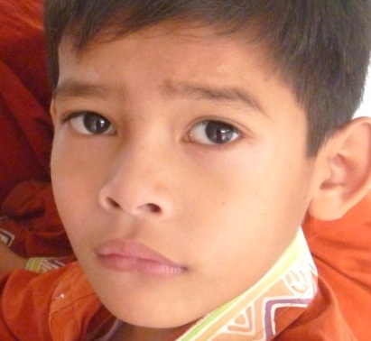
Notes:
So after all those statistics, projects and tactics, we should remind ourselves where it all starts and finishes.
This conference showcases some of the training that has already taken place for Malaysian educators through Brighton’s TELL and Fellows projects.
The future of Malaysia rests behind these eyes. Let us strive to create opportunities for these young minds.
I believe that there is a short break now, followed by our third and final workshop sessions.
Thankyou for your attendance and your attention.
*

Slide 20
Creating Opportunities
Through a Child’s Eyes

